Slide 1
Customer Segmentation (K-Means) — Retention Strategy
10,000+ customers → 5 groups → targeted actions → 30% reactivation (internal tracking)

Slide 2
Project Summary
Analyzed 10,000+ customer records using anonymized behavioral + value signals
Built a K-Means clustering model to classify customers into 5 actionable segments
Profiled each segment (recency, frequency, value) and designed targeted retention actions
Outcome: supported retention strategy that helped drive 30% customer return / reactivation

Slide 3
5 Segments → Retention Strategy Playbook
Synthetic example shown. No confidential data included.
Tier | Segment Name | Typical Profile | Retention Strategy
Tier 1 | VIP Loyalists (Most Valuable) | High value, frequent play, recent activity, long tenure | High-touch personalization: • VIP experiences (e.g., hockey tournament tickets) • Early access / exclusive perks • Reduce friction + priority support
Tier 2 | At-Risk High Value | High value but declining recency / engagement | Win-back + save strategy: • Proactive outreach • Tailored incentive • Identify blockers (support issues, friction)
Tier 3 | Deal-Driven | Medium value, high promo responsiveness | Promo personalization: • Offer timing & depth testing • A/B test messaging • Optimize channel (email vs app)
Tier 4 | New / Growing | Newer customers, lower history, strong digital engagement | Onboarding journey: • Education + habit-building nudges • Next-best action recommendations • Encourage second/third purchase
Tier 5 | Dormant / Low Engagement (Least Valuable) | Low value, low frequency, long recency | Low-cost reactivation: • Customer support outreach (email/phone) • Simple win-back offer • Suppress if low ROI

Slide 4
Key Takeaways
Segmentation made retention actions more targeted and measurable
Tier 1 received high-touch personalization (experience-based rewards)
Tier 5 focused on low-cost outreach (email/phone) to control ROI
This approach supports scalable retention strategy and campaign planning
Synthetic example shown. No confidential data included.

Slide 5
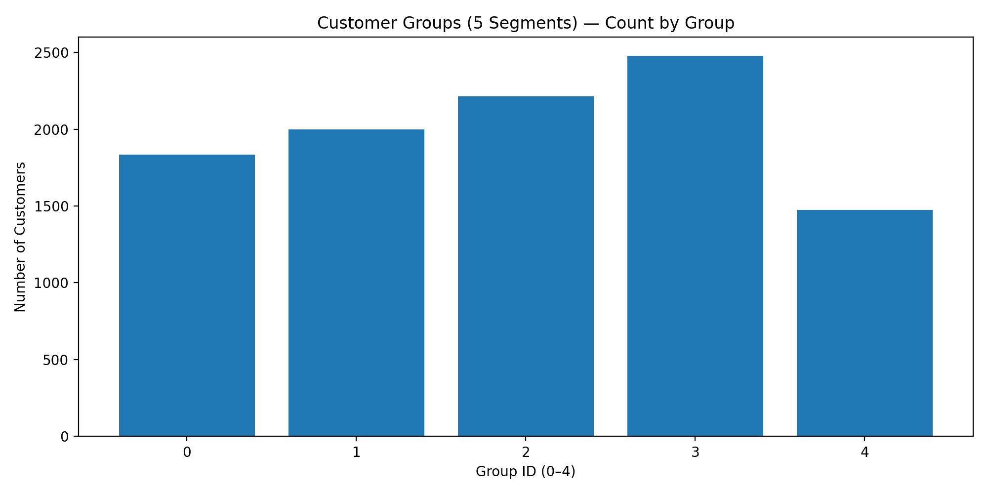
Visualization 1 — Segment Sizes

Slide 6
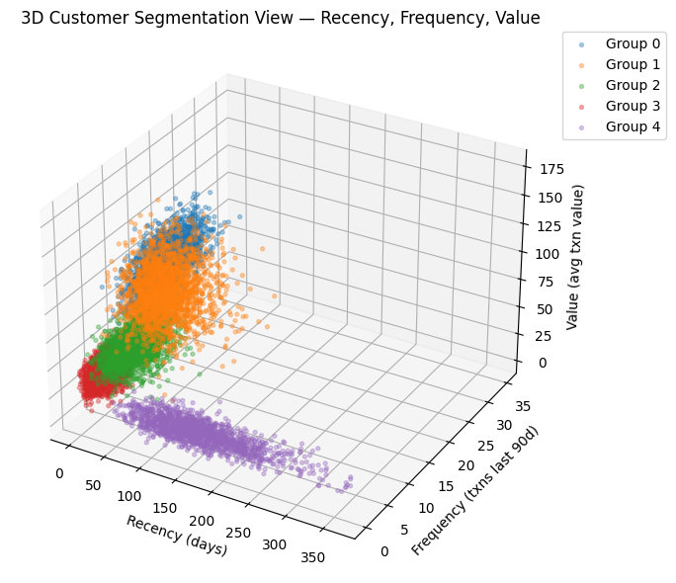
Visualization 2 — Recency， Frequency, Value (Color-coded)

Slide 7
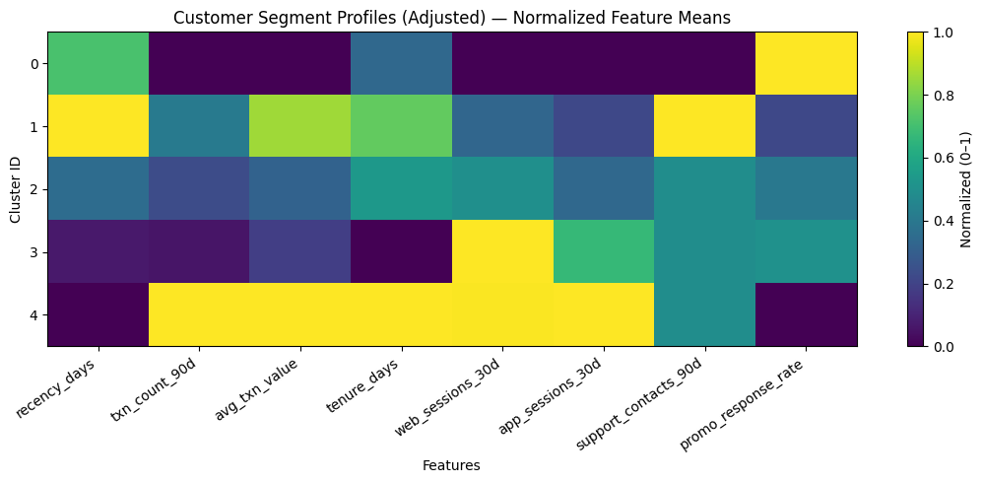

Slide 8
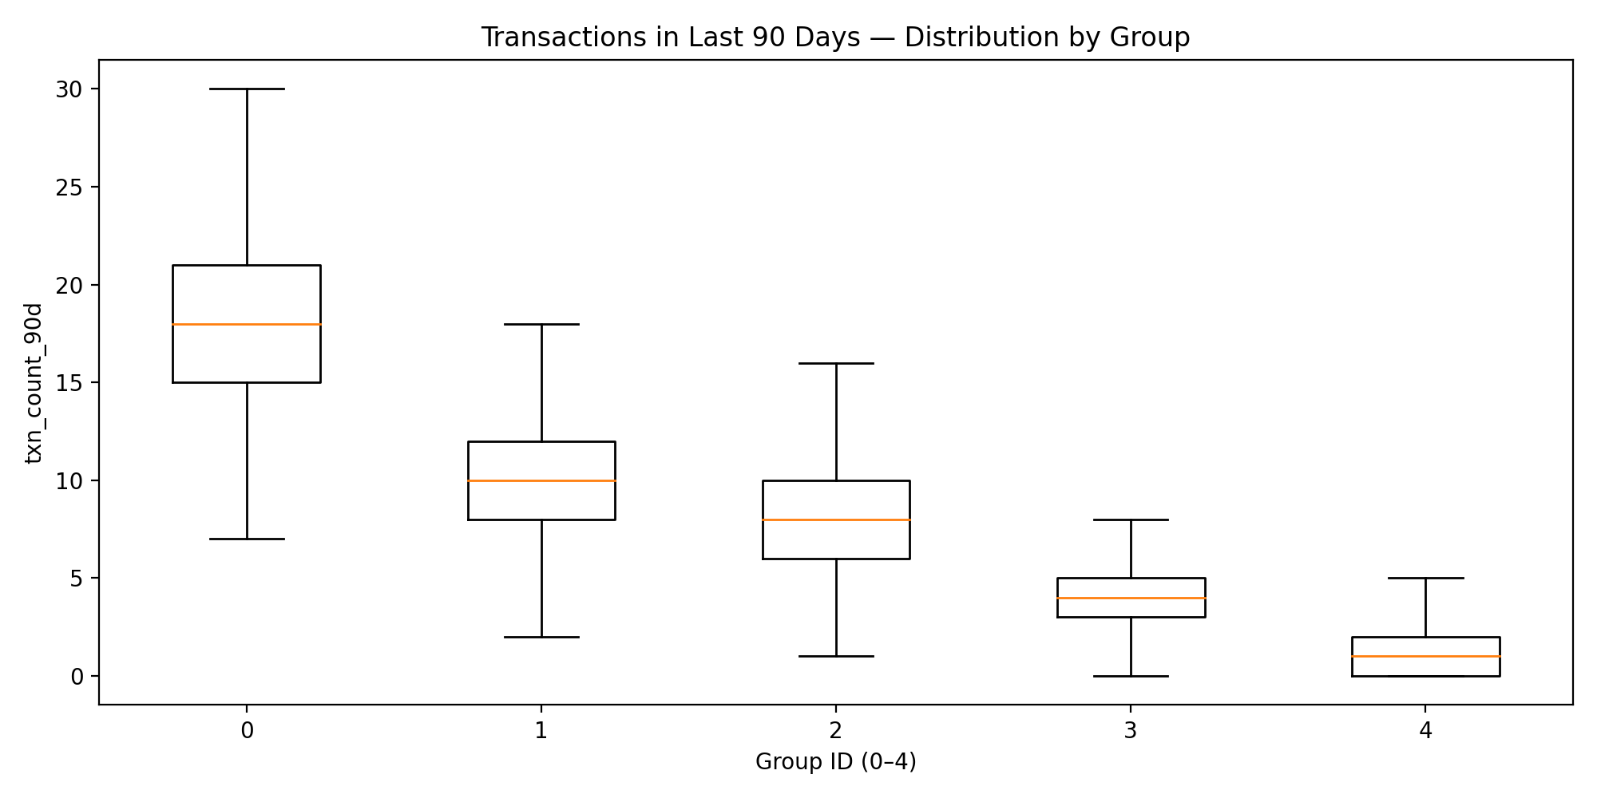
Visualization 3 — Transactions by Segment

Slide 9
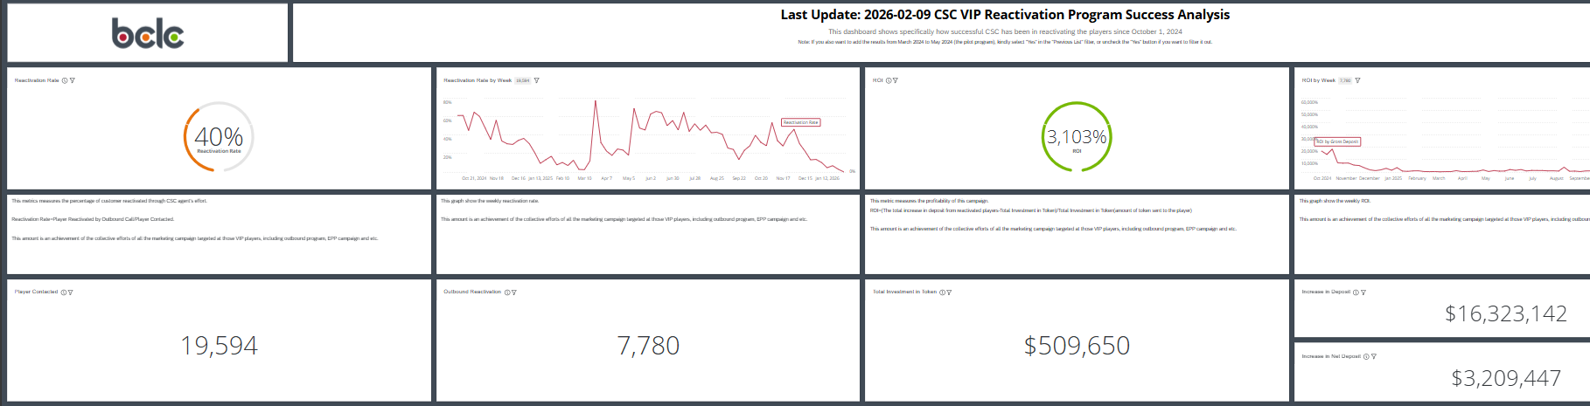
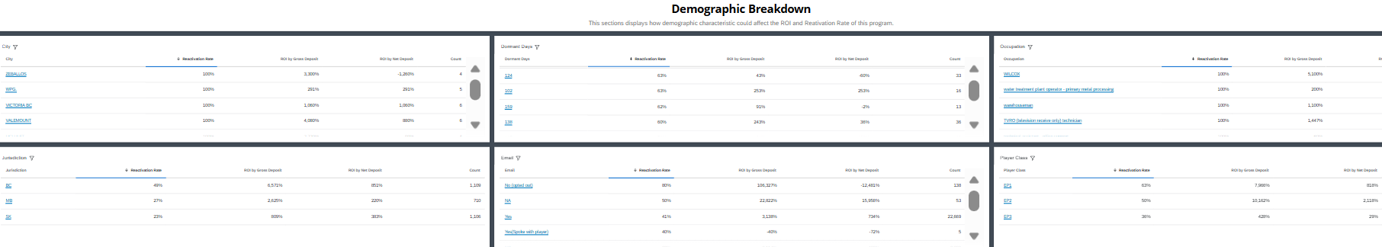
Dashboard for the Project

